Slide 1









Homeopathic medicine Analysis

Slide 2
Objective
Generate medicine aggregations by benefit area, brand, and ingredient.
Analyze pricing, ratings, and ingredient usage across benefit areas.
Create an interactive dashboard for homeopathic store cost analysis.
Provide insights for selecting the best medicine based on benefit area.

Slide 3
Project Execution
Web Scrapping
Pandas
BeautifulSoup
Data Framing
Pandas
Data Cleaning
Pandas
Excel
Dashboard and getting Insights
Excel
Pandas

Slide 4
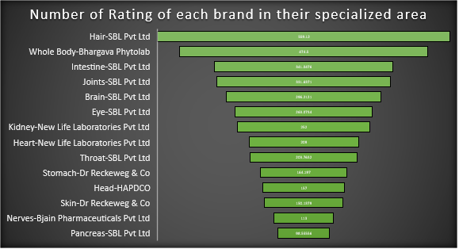
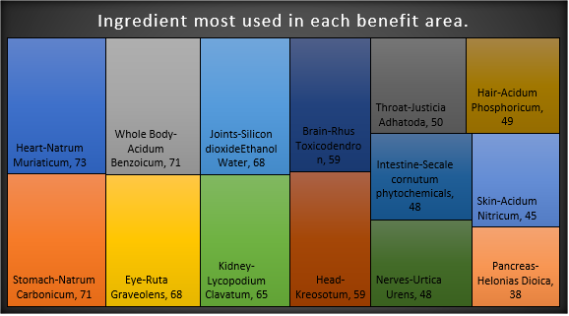
1Mg Homeopathy Dashboard

Slide 5
Project Insights
The overall most used ingredient is Belladonna.
The number of medicines in the benefits area Eye is highest.
SBL Pvt Ltd and Bjain Pharmaceuticals Pvt Ltd are the brands that have the most medicines with the average selling price of ₹144.89 and ₹132.31 respectively.
SBL Pvt Ltd has the highest average number of ratings, ₹ 559.12, in the Hair-benefit area.
The average cost for ingredients is ₹184.86.
The brand SBL Pvt Ltd has the most, greater than 4-point review on medicines.

Slide 6
Project Insights
Maximum Selling price range of medicine for each benefit area ₹ 873 to ₹ 3400.
Minimum Selling price range of medicine for each benefit area ₹ 36 to ₹ 56.
Selling Price range for Kidney is maximum i.e. 38-3400.
Selling Price range for Brain is minimum i.e. 56-873.

Slide 7
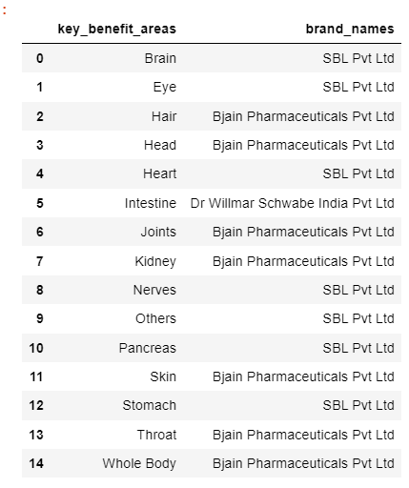
Project Insights
Brand specialization(Key Benefits) of each area
SBL Pvt Ltd and Bjain Pharmaceutical Pvt Ltd are the two brands that are used most among the benefit areas.
SBL Pvt Ltd is preferable for the medicines of Brain, Eye, Heart, Nerves, Pancreas and Stomach key benefit areas.
Bjain Pharmaceuticals Pvt Ltd is preferable for the medicines of Hair, Head, Joints, Kidney, skin and Throat key benefit areas.

Slide 8
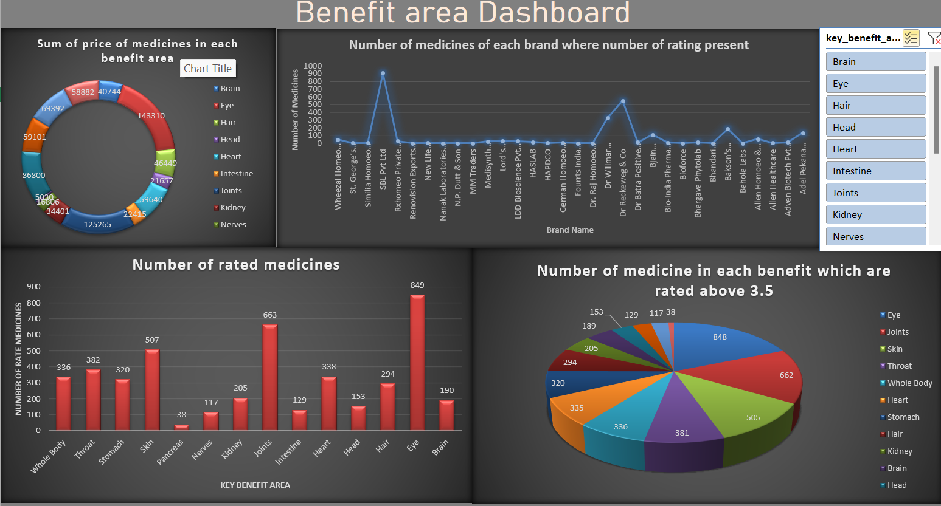

Slide 9
Summarized Insights from Dashboard
Sum of the price of medicines is highest for Eye benefit area.
The Brand SBL Pvt Ltd has the highest number of medicines where number of ratings are present.
Most rated medicine is from the Eye benefit area.
The highest number of medicine, which are rated above 3.5, is from the Eye benefit area
So, medicines of Eye benefit area would be recommended to purchase or from the brand SBL Pvt Ltd.
Medicines of Joint and Skin key benefit area would be recommended to purchase from the Bjain Pharmaceuticals Pvt Ltd

Slide 10
Challenges Faced
Got banned from the 1Mg official website multiple times while data scraping, to resolve I used Google Colab.
Scraping details of each individual medicine took longer than excepted (mainly because of some duplicate data)
Future Scope
The future scope includes incorporating ML algorithms for predicting medicine demand, personalized recommendation systems, and detecting fraudulent practices.

Slide 11
Thank You

